Slide 1
Project: Figbook
Client: Figtory Animation
Team: Creativate
Armand Pieterse 12167844
Kgomotso Sito 12243273
Jimmy Peleha 12230830
Sphelele Malo 12247040
Ndivhuwo Nthambeleni 10001183

Slide 2
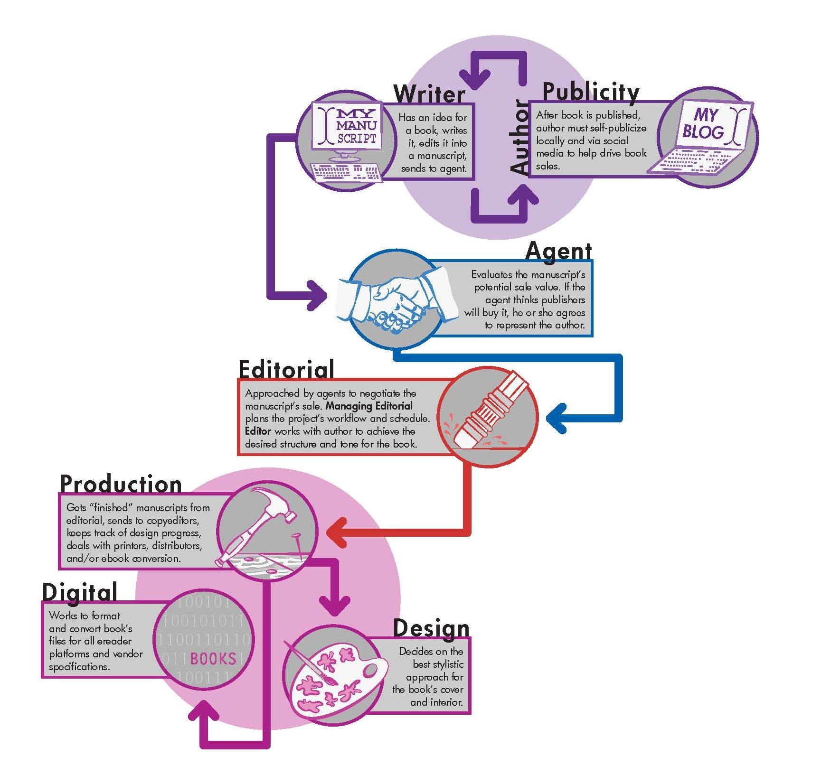
Book Publishing Life Cycle

Slide 3
Project Scope
The core of this project is to allow :
multiple authors to work on a book concurrently.
smooth communication between different user roles at the different phases of the books life cycle.
the authors to work on and see their project go from its infancy to the design and finally publishing phase.

Slide 4
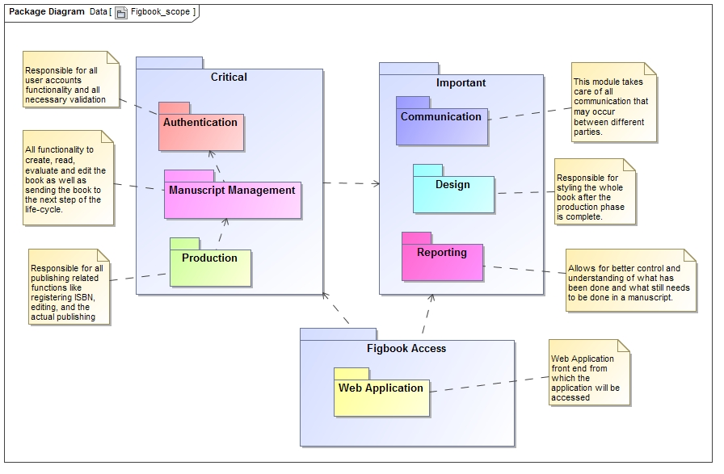

Slide 5
Project Modules
  Authentication
  Manuscript Management
  Communication
  Reporting
  Production
  Design

Slide 6
Thank you
Questions?

